Slide 1
Interdisciplinary study on young people’s needs and opportunities assessment in Cluj-Napoca, Romania
Alexandra Onișor, PhD candidate
Researcher
Department of Public Health
Babeș-Bolyai University, Cluj-Napoca
alexandra.onisor@publichealth.ro

Slide 2
LEAP: Interdisciplinary study on young people’s needs and opportunities assessment in Cluj-Napoca, Romania

Slide 3
Meeting agenda
Who are we?
The LEAP team
How we consider to respond to Botnar Foundation’s call?
Botnar Foundation’s requirements
Design of the LEAP project
Why are you here?
Shared vision on stakeholder engagement

Slide 4
01
The LEAP team

Slide 5
The LEAP team
2006
2009
2011
2015
College of Psychology
UBB
Master Program: Mental Health in Children and Adolescents
College of Psychology, UBB
Department of Public Health FSPAC, UBB
PhD program: Administration and Public Policies, UBB
2007
2011
Developmental psychology lab
College of Psychology, UBB
(Dr. Oana Benga; Dr. Thea Ionescu)
Research projects involving youths
PRO-YOUTH, ANARo, NiLSA, JANPA
Calitex, PRISM, PERSIST, RESPREMO,
mHealth

Slide 6
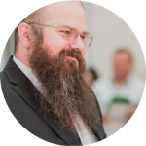
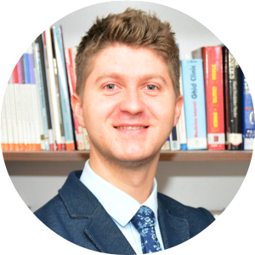
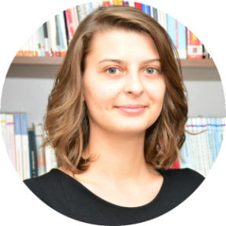
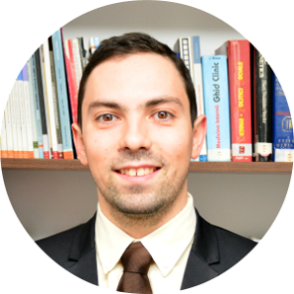
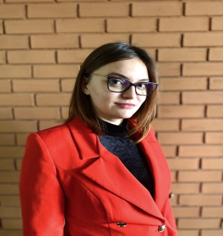
Consultancy
Răzvan M. Cherecheș, MD, PhD
Financial & administrative management
Elena Bozdog, PhD student
Naomi Popovici, MA student
Technical implementation
Alexandra Onișor, PhD student
Andreea Rusu, PhD student
Oana Blaga, PhD
Petru Sandu, MD, PhD
Marina Dascăl, MA student
Carina Țintaș, BA student
Vlad Bejenariu, BA student
Marius Ungureanu
MD, PhD
Everything ☺
Monica Brinzac, MA student

Slide 7
thE ENTIRE COMMUNITY
The LEAP team
COMMUNITIES OF THE CLUJ METROPOLITAN AREA
STAKEHOLDERS
ADVISORY COMMITTEE
PONT
SPH
CCC
PS

Slide 8
02
Our response:
The LEAP study

Slide 9
Fundation Botnar
2020
2030
20..
Invest in innitiatives that will help the city better address youths’ needs
Needs, gaps, opportunities assessment
Cluj-Napoca
Child/Youth friendly city
Scale up
practices
in other cities
Systemic
thinking
Participatory
approach
Digitalization
Co-creation

Slide 10
UNICEF: Child Friendly Cities Initiative
“A child-friendly city (CFC) is a city, town, community or any system of local governance committed to improving the lives of children within their jurisdiction by realizing their rights as articulated in the UN Convention of the Rights of the Child.”
“In practice, it is a city, town or community in which the voices, needs, priorities and rights of children are an integral part of public policies, programmes and decisions.”

Slide 11
UNICEF: Child Friendly Cities Initiative
Are protected from exploitation, violence and abuse.
Have a good start in life and grow up healthy and cared for.
Have access to quality social services.
Experience quality, inclusive and participatory education and skills development.
Express their opinions and influence decisions that affect them.
Participate in family, cultural, city/community and social life.
Live in a safe secure and clean environment with access to green spaces.
Meet friends and have places to play and enjoy themselves.
Have a fair chance in life regardless of their ethnic origin, religion, income, gender or ability.

Slide 12
Fundation Botnar
2020
2030
20..
Invest in innitiatives that will help the city better address youths’ needs
Needs, gaps, opportunities assessment
Cluj-Napoca
Child/Youth friendly city
Scale up
practices
in other cities
Systemic
thinking
Participatory
approach
Digitalization
Co-creation

Slide 13
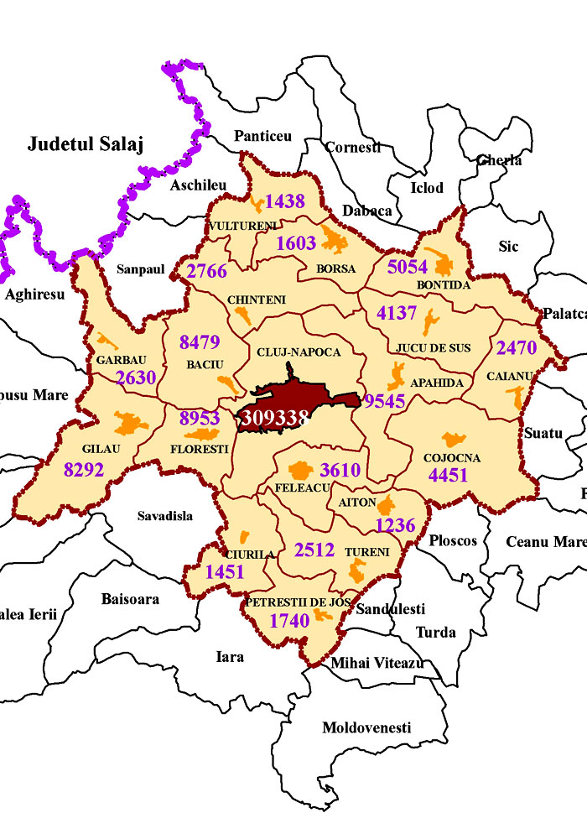
Input
When: 4 months period
Where: Cluj Metropolitan area
Who: children and youths aged 10 to 24
Partners & Advisory Committee
Use a participatory approach
LEAP study design
The process
???
Output
Priorities areas of action to address needs, gaps and opportunities for children and youths aged 10 to 24

Slide 14
LEAP study design
General frameworks and tools used in similar initiatives
Literature review
Report on previous research results
IDENTIFY
Results of past research on children & youths from Cluj MA
Key informants/stakeholders
Stakeholder identification
Stakeholder map
ASSESS
Current status of needs in children & youths
Quantitative and qualitative data collection
Report on current needs
Policies
Policy analysis, policy game
Policy recommendations
PRIORITIZE
Opportunities
Round table discussions
Final report

Slide 15
LEAP study design
Environmental scan
Literature review
Stakeholder identification
Consultations
with stakeholders
Interviews
Round table discussions
Policy game
Engagement of young people
Representative survey
Focus groups, interviews
N
G
O
A
R
E
P
O
R
T
Identify topics to be addressed
Identify and summarize available results
Develop the data collection tools
Improve and prioritize topics to be addressed
Add information to available results
Improve the data collection tools
Prioritize NGO
Improve and prioritize topics to be addressed
Add information to available results
Improve the data collection tools
Prioritize NGO
Identify current NGO

Slide 16
03
Stakeholder engagement

Slide 17
The LEAP team
Advisory Committee
representatives of external organizations in the areas of education and health & well-being for young people with the purpose to ensure the transfer and usability of the project findings, and contribute to project sustainability
Has a consultative role
Meeting #1: at the beginning of the project, within the premises of the kick-off meeting; aim: PAC members to be familiarized with the project aims and approaches.
Meeting #2: intermediary meeting, once the draft research tools are developed; aim: receive feedback on the draft research tools
Meeting #3: end of project; aim: discuss usability of research findings and sustainability mechanisms

Slide 18
Interdisciplinary study on young people’s needs and opportunities assessment in Cluj-Napoca, Romania
Alexandra Onișor, PhD candidate
Researcher
Department of Public Health
Babeș-Bolyai University, Cluj-Napoca
alexandra.onisor@publichealth.ro

Slide 20
The LEAP team
Consortium partners
Federația Tinerilor din Cluj (Cluj Youth Federation)
Someș Delivery
Pilot grants (Wello, MagicHelp, Romanian Health Observatory)
Cluj City Hall
Direcția de Asitneță Socială și Medicală (Health and Social Care Directorate)
Centrul de Știința Datelor (Center for Data Science)
Direcția de Sănătate Publică (County Public Health Directorate)
Centrul Regional de Sănătate Publică (Regional Center for Public Health)
Inspectoratul Școlar Județean (County School Inspectorate)
Fundația Noi Orizonturi (New Horizons Foundation)
Transylvania College

